Slide 1
CPU Scheduling
First Come First Serve
Shortest Job First

Slide 2
Name

Slide 3
First Come First Serve
ALGORITHM:
1. Start the program.
2. Get the number of processes and their burst time.
3. Initialize the waiting time for process 1 and 0.
4. Process for(i=2;i<=n;i++),wt.p[i]=p[i-1]+bt.p[i-1].
5. The waiting time of all the processes is summed then average value time is calculated.
6. The waiting time of each process and average times are displayed
7. Stop the program

Slide 4
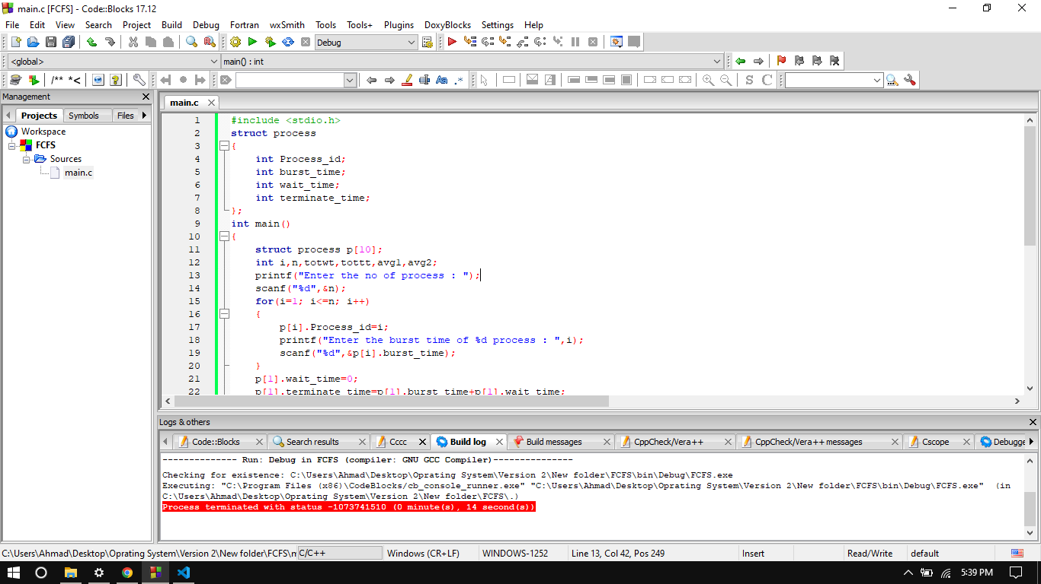
First Come First Serve

Slide 5
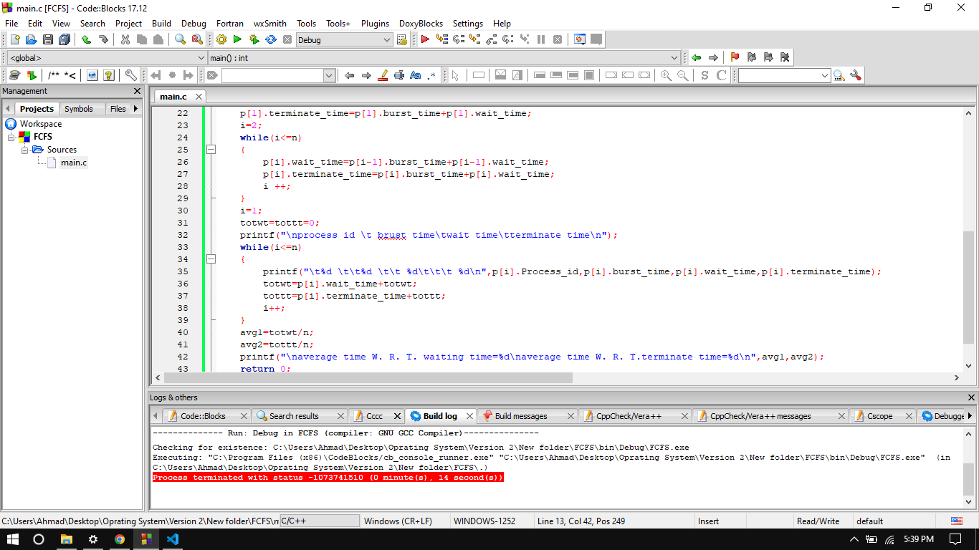
First Come First Serve

Slide 6
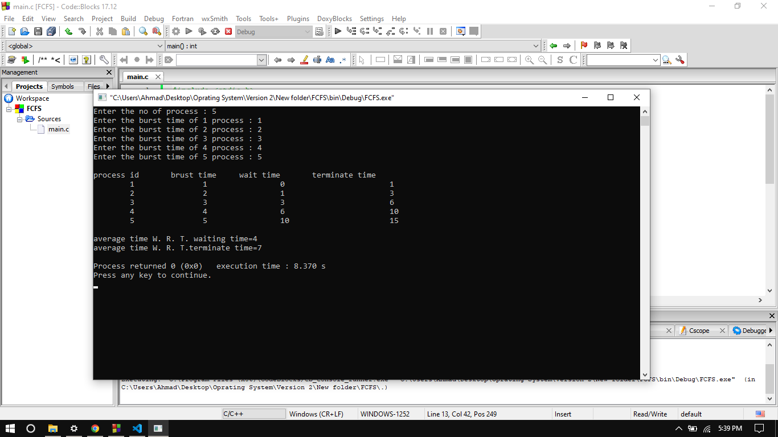
First Come First Serve

Slide 7
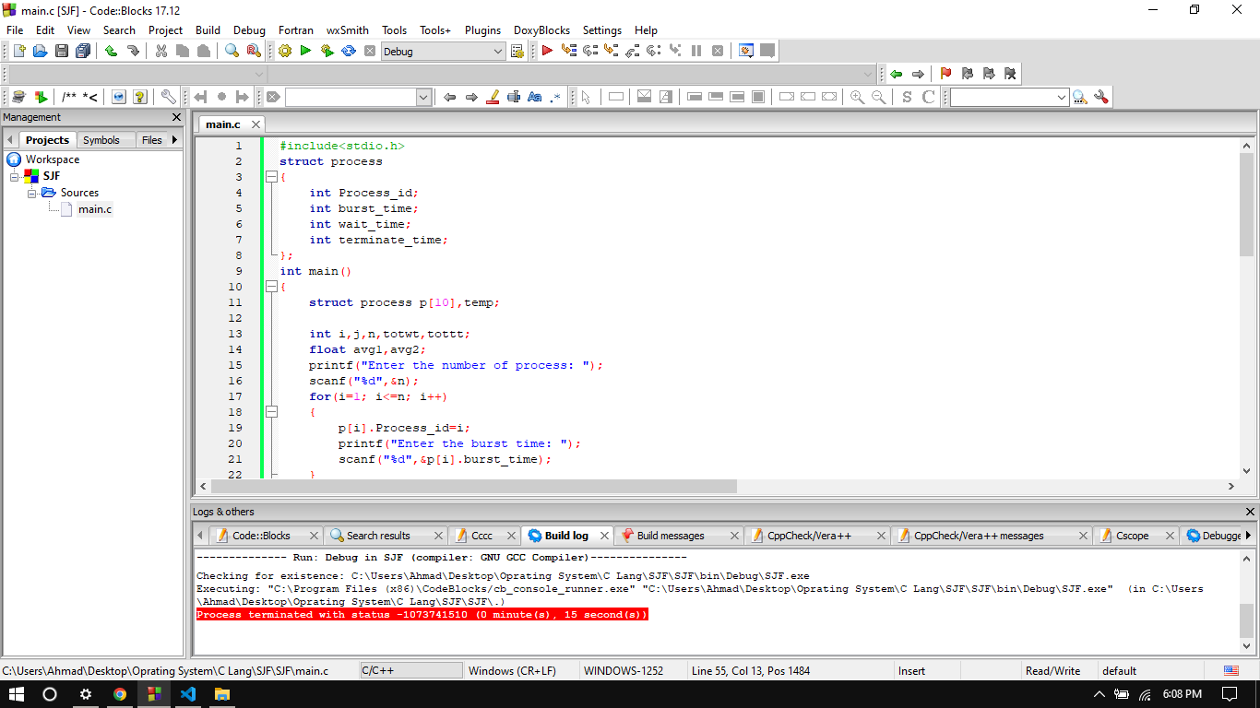
Shortest Job First

Slide 8
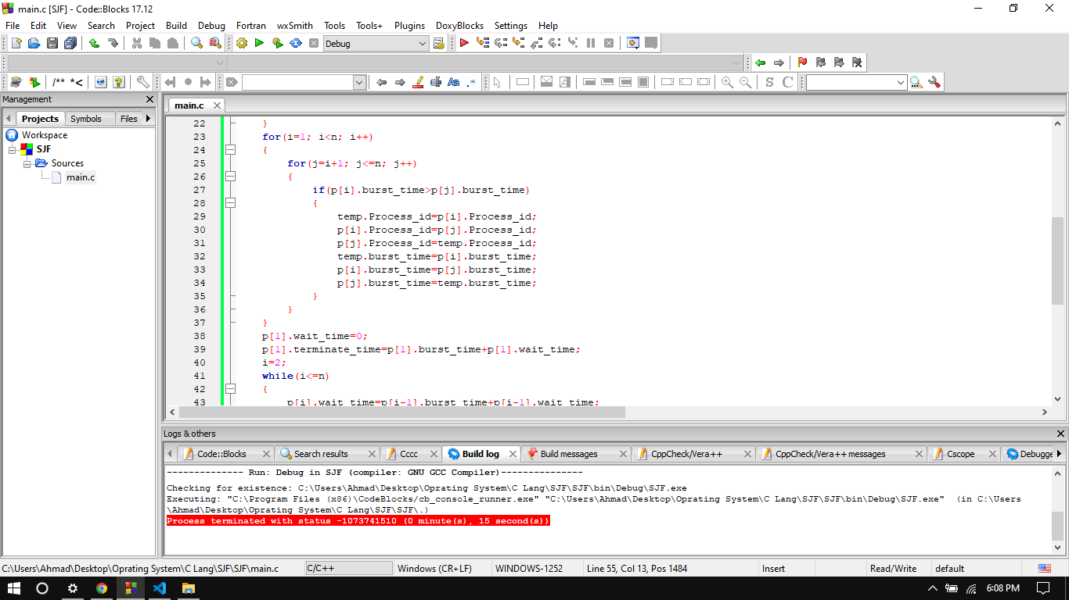
Shortest Job First

Slide 9

Shortest Job First

Slide 10
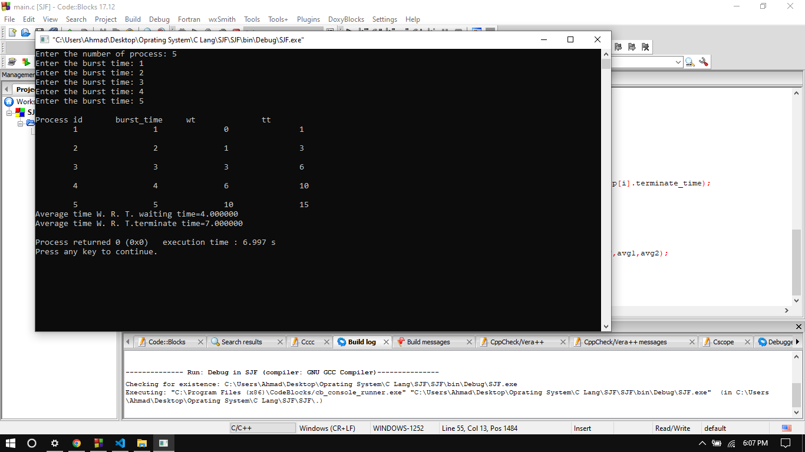
Shortest Job First

Slide 11
Shortest Job First
1. Start the program. Get the number of processes and their burst time.
2. Initialize the waiting time for process 1 as 0.
3. The processes are stored according to their burst time.
4. The waiting time for the processes are calculated a follows:
for(i=2;i<=n;i++).wt.p[i]=p[i=1]+bt.p[i-1].
5. The waiting time of all the processes summed and then the average time is calculate
6. The waiting time of each processes and average time are displayed.
Stop the program.

Slide 12
Features of scheduling
Response Time: ...
Turnaround time: ...
Waiting time: ...
Fairness:
Utilization of CPU

Slide 13
manual instructing for new user FCFS
First of all I tell you about the instructing of first come first serve you need to input the total number of processes
Then need input burst time of each process
After then our program calculates the waiting time and then show on-screen total termination time as you can see above the picture

Slide 14
manual instructing for new user SJF
First you need to enter the total number of process
Then You need to enter the burset time
then our program will be the show waiting , terminate , burt time
And also in the end of program will be show average total time and terminate time

Slide 15
The breakup of tasks across team members
/////

